Slide 1

Class: 4C
Duc Giang primary school
Teacher: Trần Trâm Anh

Slide 2




Warm up
hangman

Slide 3
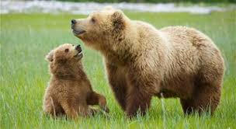
bears

Slide 4
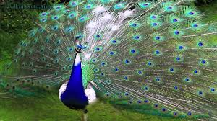
A peacock

Slide 5
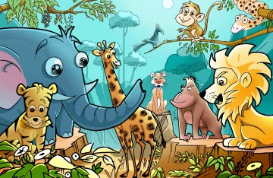
Monday, April 17th 2017
Unit 19: What animal do you want to see?
Lesson 1

Slide 6

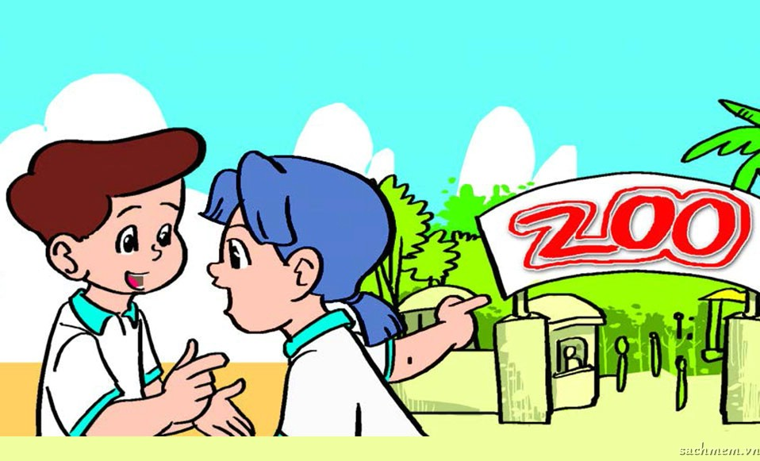

Slide 8


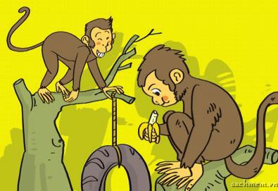
monkeys

Slide 9
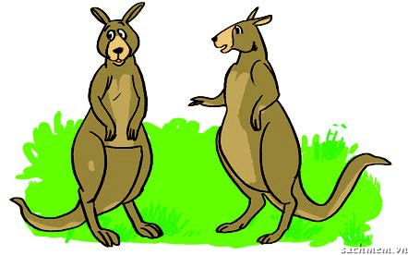
Kangaroos

Slide 10
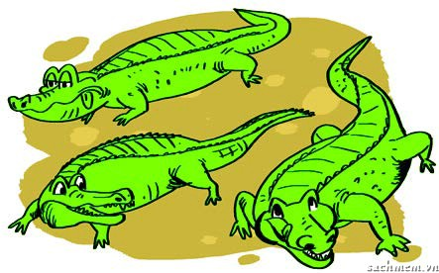
Crocodiles

Slide 11
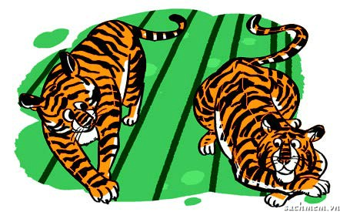
Tigers

Slide 12
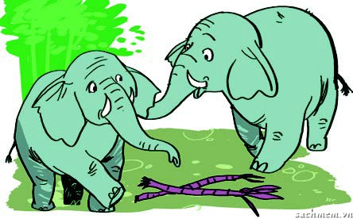
Elephants

Slide 13
15
00
01
02
03
04
05
06
07
08
09
10
11
12
13
14

Slide 14

I./ New words.
Monkeys: những con khỉ.
Kangaroos: những con chuột túi.
Crocodiles: những con cá sấu.
Tigers: những con hổ.
Elephants: những con voi
II./ Model Sentences.
What animal do you want to see?
I want to see monkeys.

Slide 15

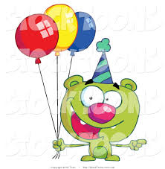
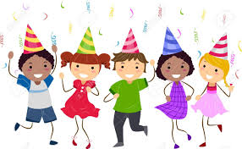

Games
MAGIC BOX

Slide 16
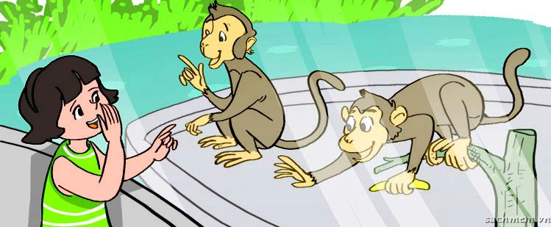
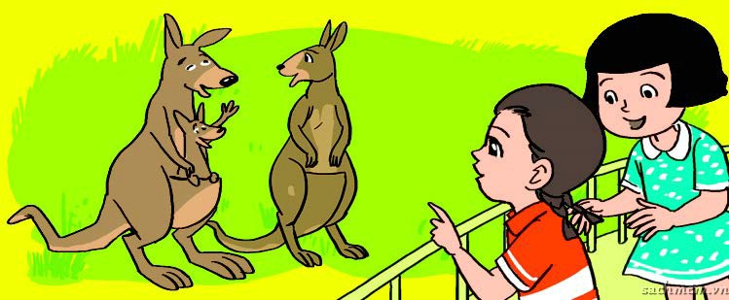
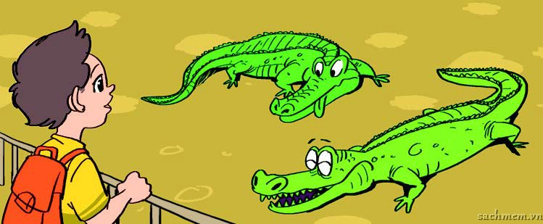
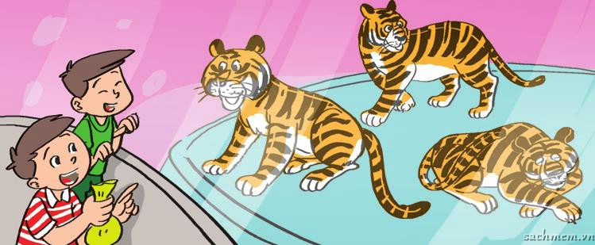
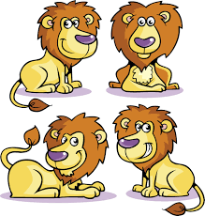
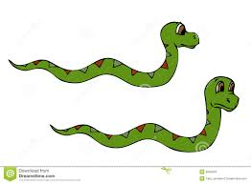
10
She wants to see monkeys.
A
-5
I want to see elephants.
B
50
They want to see kangaroos.
C
10
He wants to see crocodiles.
D
20
I want to see tigers.
E
30
They want to see tigers.
F
-5
I want to see lions.
G
20
I want to see snakes.
H
5
I want to see bears.
I

Slide 17
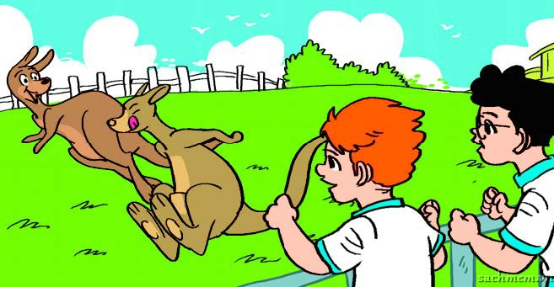
10
They want to see kangaroos.
W

Slide 18
Thanks your attention

